Slide 1
Memory Hierarchy
國立清華大學資訊工程學系
黃婷婷教授

Slide 2
Outline
Memory hierarchy
The basics of caches
Direct-mapped cache
Address sub-division
Cache hit and miss
Memory support
Measuring cache performance
Improving cache performance
Set associative cache
Multiple level cache
Virtual memory
Basics
Handling huge page table
TLB (Translation Lookaside Buffer)
TLB and cache
A common framework for memory hierarchy

Slide 3
Memory Technology
Random access:
Access time same for all locations
SRAM: Static Random Access Memory
Low density, high power, expensive, fast
Static: content will last (forever until lose power)
Address not divided
Use for caches
DRAM: Dynamic Random Access Memory
High density, low power, cheap, slow
Dynamic: need to be refreshed regularly
Addresses in 2 halves (memory as a 2D matrix):
RAS/CAS (Row/Column Access Strobe)
Use for main memory
Magnetic disk
Notes:
The technology we used to build our memory hierarchy can be divided into two categories: Random Access and Non-so-Random Access.
Unlike all other aspects of life where the word random usually associates with bad things, random, when associates with memory access, for the lack of a better word, is good!
Because random access means you can access any random location at any time and the access time will be the same as any other random locations.
Which is NOT the case for disks or tape where the access time for a given location at any time can be quite different from some other random locations at some other random time.
As far as Random Access technology is concerned, we will concentrate on two specific technologies: Dynamic RAM and Static RAM.
The advantages of Dynamic RAMs are high density, low cost, and low power so we can have a lot of them without burning a hole in our budget or our desktop.
The disadvantages of DRAM are they are slow. Also they will forget what you tell them if you don remind them constantly (Refresh). We will talk more about refresh later today.
SRAM only has one redeeming feature: it is fast. Other than that, they have low density, expensive, and burn a lot of power. Oh, SRAM actually has another redeeming feature. They will not forget what you tell them. They will keep whatever you write to them forever.
Well orever?is a long time. So lets just say it will keep your data as long as you don pull the plug on your computer.
In the next two lectures, we will be focusing on DRAMs and SRAMs.
We will not get into disk until the Virtual Memory lecture a week from now.
+3 = 19 min. (X:59)

Slide 4
Comparisons of Various Technologies
Memory
technology
Typical access
time
$ per GB
in 2008
SRAM
0.5 – 2.5 ns
$2000 – $5,000
DRAM
50 – 70 ns
$20 – $75
Magnetic
disk
5,000,000 –
20,000,000 ns
$0.20 – $2
Ideal memory
Access time of SRAM
Capacity and cost/GB of disk
Notes:
From the truth table we had before the break, we can derive the logic equation for ALUctr bit 2 but collecting all the rows that has ALUCtr bit 2 equals to 1 and this table is the result.
Each row becomes a product term and we need to OR the prodcut terms together.
Notice that the last row are identical except the bit<3> of the func fields. One is zero and the other is one. Together, they make bit<3> a don care term.
With all these don care terms, the logic equation is rather simple.
The first prodcut term is: not ALUOp<2> and ALUOp<0>.
The second product term, after we making Func<3> a don care becomes ...
+2 = 57 min. (Y:37)

Slide 5
Solution: Memory Hierarchy
An Illusion of a large, fast, cheap memory
Fact: Large memories slow, fast memories small
How to achieve: hierarchy, parallelism
An expanded view of memory system:
Processor
Control
Memory
Memory
Datapath
Memory
Memory
Memory
Speed:
Fastest
Slowest
Size:
Smallest
Biggest
Cost:
Highest
Lowest

Slide 6
Memory Hierarchy: Principle
At any given time, data is copied between only two adjacent levels:
Upper level: the one closer to the processor
Smaller, faster, uses more expensive technology
Lower level: the one away from the processor
Bigger, slower, uses less expensive technology
Block: basic unit of information transfer
Minimum unit of information that can either be present or not present in a level of the hierarchy
Lower Level
Memory
To Processor
Upper Level
Memory
Block X
From Processor
Block Y

Slide 7
Why Hierarchy Works?
Principle of Locality:
Program access a relatively small portion of the address space at any instant of time
90/10 rule: 10% of code executed 90% of time
Two types of locality:
Temporal locality: if an item is referenced, it will tend to be referenced again soon, e.g., loop
Spatial locality: if an item is referenced, items whose addresses are close by tend to be referenced soon., e.g., instruction access, array data structure
Probability
of reference
0
address space
2^{n} - 1
Notes:
The principle of locality states that programs access a relatively small portion of the address space at any instant of time.
This is kind of like in real life, we all have a lot of friends. But at any given time most of us can only keep in touch with a small group of them.
There are two different types of locality: Temporal and Spatial. Temporal locality is the locality in time which says if an item is referenced, it will tend to be referenced again soon.
This is like saying if you just talk to one of your friends, it is likely that you will talk to him or her again soon.
This makes sense. For example, if you just have lunch with a friend, you may say, let go to the ball game this Sunday. So you will talk to him again soon.
Spatial locality is the locality in space. It says if an item is referenced, items whose addresses are close by tend to be referenced soon.
Once again, using our analogy. We can usually divide our friends into groups. Like friends from high school, friends from work, friends from home.
Let say you just talk to one of your friends from high school and she may say something like: o did you hear so and so just won the lottery.
You probably will say NO, I better give him a call and find out more.
So this is an example of spatial locality. You just talked to a friend from your high school days. As a result, you end up talking to another high school friend. Or at least in this case, you hope he still remember you are his friend.
+3 = 10 min. (X:50)
Temporal locality: loop
Spatial locality: instruction executed sequentially, access of array element.

Slide 8
Upper Level
Staging
Transfer Unit
faster
Registers
Instr. Operands
prog./compiler
Cache
Blocks
cache controller
Memory
OS
Pages
Disk
Files
user/operator
Tape
Larger
Lower Level

Slide 9
How Is the Hierarchy Managed?
Registers <-> Memory
by compiler (programmer?)
cache <-> memory
by the hardware
memory <-> disks
by the hardware and operating system (virtual memory)
by the programmer (files)

Slide 10
Memory Hierarchy: Terminology
Hit: data appears in upper level (Block X)
Hit rate: fraction of memory access found in the upper level
Hit time: time to access the upper level
RAM access time + Time to determine hit/miss
Miss: data needs to be retrieved from a block in the lower level (Block Y)
Miss Rate = 1 - (Hit Rate)
Miss Penalty: time to replace a block in the upper level + time to deliver the block to the processor (latency + transmit time)
Hit Time << Miss Penalty
Lower Level
Memory
To Processor
Upper Level
Memory
From Processor
Block X
Block Y
Notes:
A HIT is when the data the processor wants to access is found in the upper level (Blk X).
The fraction of the memory access that are HIT is defined as HIT rate.
HIT Time is the time to access the Upper Level where the data is found (X). It consists of:
(a) Time to access this level.
(b) AND the time to determine if this is a Hit or Miss.
If the data the processor wants cannot be found in the Upper level. Then we have a miss and we need to retrieve the data (Blk Y) from the lower level.
By definition (definition of Hit: Fraction), the miss rate is just 1 minus the hit rate.
This miss penalty also consists of two parts:
(a) The time it takes to replace a block (Blk Y to BlkX) in the upper level.
(b) And then the time it takes to deliver this new block to the processor.
It is very important that your Hit Time to be much much smaller than your miss penalty. Otherwise, there will be no reason to build a memory hierarchy.
+2 = 14 min. (X:54)

Slide 11
4 Questions for Hierarchy Design
Q1: Where can a block be placed in the upper level? => block placement
Q2: How is a block found if it is in the upper level? => block finding
Q3: Which block should be replaced on a miss? => block replacement
Q4: What happens on a write? => write strategy

Slide 12
Summary of Memory Hierarchy
Two different types of locality:
Temporal Locality (Locality in Time)
Spatial Locality (Locality in Space)
Using the principle of locality:
Present the user with as much memory as is available in the cheapest technology.
Provide access at the speed offered by the fastest technology.
DRAM is slow but cheap and dense:
Good for presenting users with a BIG memory system
SRAM is fast but expensive, not very dense:
Good choice for providing users FAST accesses
Notes:
Let summarize today lecture. The first thing we covered is the principle of locality.
There are two types of locality: temporal, or locality of time and spatial, locality of space.
We talked about memory system design.
The key idea of memory system design is to present the user with as much memory as possible in the cheapest technology while by taking advantage of the principle of locality, create an illusion that the average access time is close to that of the fastest technology.
As far as Random Access technology is concerned, we concentrate on 2: DRAM and SRAM.
DRAM is slow but cheap and dense so is a good choice for presenting the use with a BIG memory system.
SRAM, on the other hand, is fast but it is also expensive both in terms of cost and power, so it is a good choice for providing the user with a fast access time.
I have already showed you how DRAMs are used to construct the main memory for the SPARCstation 20.
On Friday, we will talk about caches.
+2 = 78 min. (Y:58)

Slide 13
Outline
Memory hierarchy
The basics of caches
Direct-mapped cache
Address sub-division
Cache hit and miss
Memory support
Measuring cache performance
Improving cache performance
Set associative cache
Multiple level cache
Virtual memory
Basics
Handling huge page table
TLB (Translation Lookaside Buffer)
TLB and cache
A common framework for memory hierarchy

Slide 14
Processor Memory Latency Gap
1000
Proc
60%/yr.
(2X/1.5 yr)
Moore’s Law
100
Processor-memory
performance gap: (grows 50% / year)
Performance
10
DRAM
9%/yr.
(2X/10 yrs)
1
1980
Year
1981
1982
1983
1984
1985
1986
1987
1988
1989
1990
1991
1992
1993
1994
1995
1996
1997
1998
1999
2000
Notes:
Y-axis is performance
X-axis is time
Latency
Clich?
Not e that x86 didn have cache on chip until 1989

Slide 15
Levels of Memory Hierarchy
Upper Level
Staging
Transfer Unit
faster
Registers
Instr. Operands
prog./compiler
Cache
Blocks
cache controller
Memory
Pages
OS
Disk
Files
user/operator
Larger
Tape
Lower Level

Slide 16
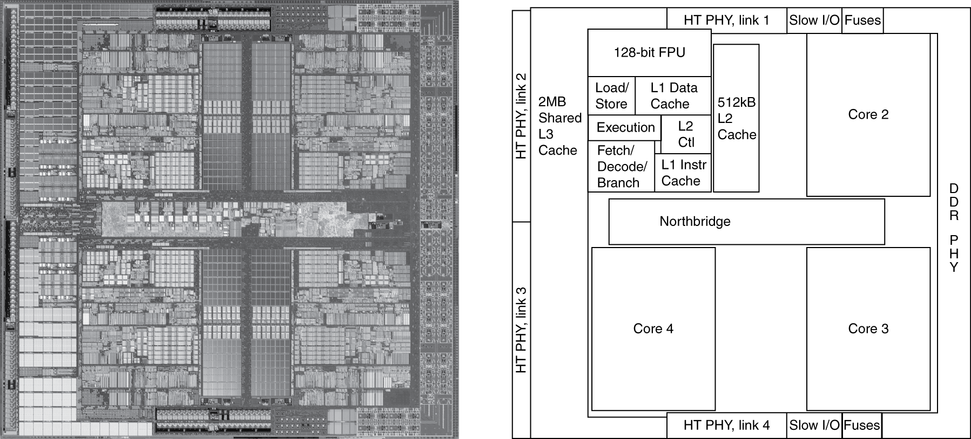
Inside the Processor
AMD Barcelona: 4 processor cores
Computer Abstractions and Technology-15

Slide 17
Basics of Cache
Our first example: direct-mapped cache
Block Placement :
For each item of data at the lower level, there is exactly one location in cache where it might be
Address mapping: modulo number of blocks
0
1
0
1
0
1
0
1
0
0
1
1
0
0
1
1
0
0
0
0
1
1
1
1
0
0
0
0
1
0
0
1
0
1
0
1
0
0
1
0
1
1
0
1
1
0
0
0
1
1
0
1
0
1
1
1
0
0
1
1
1
1
0
1
M
e
m
o
r
y

Slide 18
Tags and Valid Bits: Block Finding
How do we know which particular block is stored in a cache location?
Store block address as well as the data
Actually, only need the high-order bits
Called the tag
What if there is no data in a location?
Valid bit: 1 = present, 0 = not present
Initially 0

Slide 19
Cache Example
8-blocks, 1 word/block, direct mapped
Initial state
Index | V | Tag | Data
000 | N
001 | N
010 | N
011 | N
100 | N
101 | N
110 | N
111 | N

Slide 20
Cache Example
Word addr | Binary addr | Hit/miss | Cache block
22 | 10 110 | Miss | 110
Index | V | Tag | Data
000 | N
001 | N
010 | N
011 | N
100 | N
101 | N
110 | Y | 10 | Mem[10110]
111 | N

Slide 21
Cache Example
Word addr | Binary addr | Hit/miss | Cache block
26 | 11 010 | Miss | 010
Index | V | Tag | Data
000 | N
001 | N
010 | Y | 11 | Mem[11010]
011 | N
100 | N
101 | N
110 | Y | 10 | Mem[10110]
111 | N

Slide 22
Cache Example
Word addr | Binary addr | Hit/miss | Cache block
22 | 10 110 | Hit | 110
26 | 11 010 | Hit | 010
Index | V | Tag | Data
000 | N
001 | N
010 | Y | 11 | Mem[11010]
011 | N
100 | N
101 | N
110 | Y | 10 | Mem[10110]
111 | N

Slide 23
Cache Example
Word addr | Binary addr | Hit/miss | Cache block
16 | 10 000 | Miss | 000
3 | 00 011 | Miss | 011
16 | 10 000 | Hit | 000
Index | V | Tag | Data
000 | Y | 10 | Mem[10000]
001 | N
010 | Y | 11 | Mem[11010]
011 | Y | 00 | Mem[00011]
100 | N
101 | N
110 | Y | 10 | Mem[10110]
111 | N

Slide 24
Cache Example
Word addr | Binary addr | Hit/miss | Cache block
18 | 10 010 | Miss | 010
Index | V | Tag | Data
000 | Y | 10 | Mem[10000]
001 | N
010 | Y | 11->10 | Mem[10010]
011 | Y | 00 | Mem[00011]
100 | N
101 | N
110 | Y | 10 | Mem[10110]
111 | N

Slide 25
Outline
Memory hierarchy
The basics of caches
Direct-mapped cache
Address sub-division
Cache hit and miss
Memory support
Measuring cache performance
Improving cache performance
Set associative cache
Multiple level cache
Virtual memory
Basics
Handling huge page table
TLB (Translation Lookaside Buffer)
TLB and cache
A common framework for memory hierarchy

Slide 26
Memory Address
100000
100001
100010
100011
100100
100101
100110
100111
101000

Slide 27
Address Subdivision
Cache:
1K words, 1-word block:
Cache index: lower 10 bits
Cache tag: upper 20 bits
Valid bit (When start up, valid is 0)

Slide 28
Example: Larger Block Size
64 blocks, 16 bytes/block
To what block number does address 1200 map?
Block address = ⎣1200/16⎦ = 75
Block number = 75 modulo 64 = 11
1200=00…00100101100002 /100002 =>00…0010010112
10010112 =>0010112
31
10
9
4
3
0
Tag
Index
Offset
22 bits
6 bits
4 bits

Slide 29
Example: Intrinsity FastMATH
28
Embedded MIPS processor
12-stage pipeline
Instruction and data access on each cycle
Split cache: separate I-cache and D-cache
Each 16KB: 256 blocks × 16 words/block

Slide 30
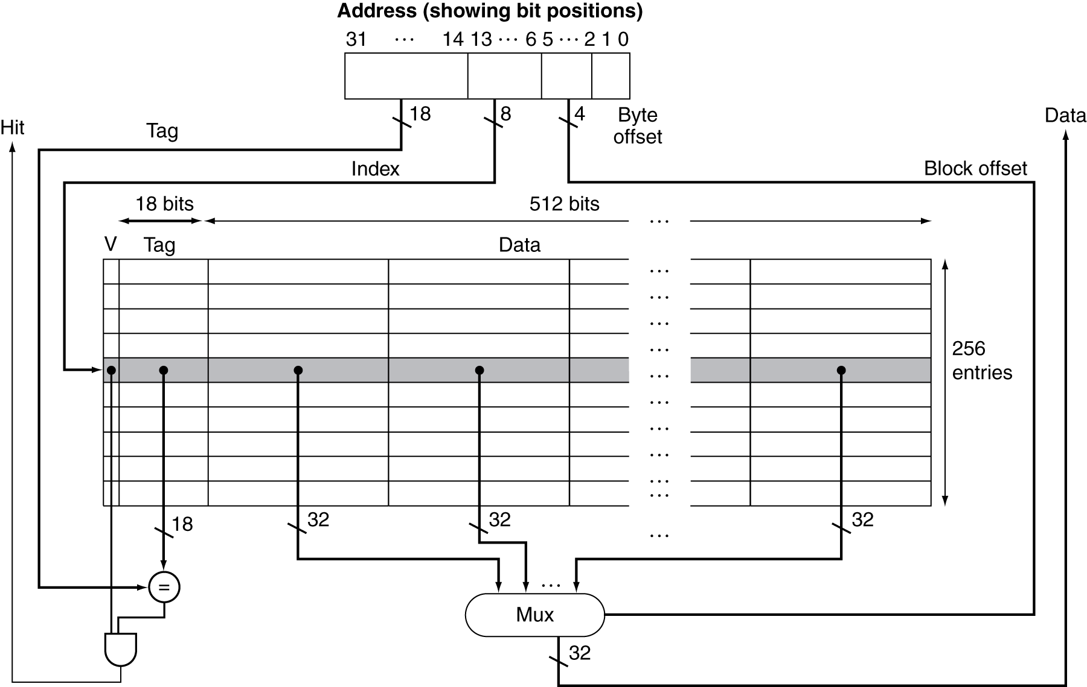
Example: Intrinsity FastMATH
Cache: 16KB
256( )blocks ×
16 ( ) words/block
29

Slide 31
Block Size Considerations
Larger blocks should reduce miss rate
Due to spatial locality
But in a fixed-sized cache
Larger blocks ⇒ fewer of them
More competition ⇒ increased miss rate
Larger miss penalty
Larger blocks ⇒ pollution
Can override benefit of reduced miss rate
Early restart and critical-word-first can help
Notes:
Eearly restart: to resume the execution as soon as the requested word of block is returned rather than wait for the entire block. Work good for instruction.
critical word first: the requested word is transferred first. Then the remaining transfer start from the word next to the requested word and wrapping around to the beginning.

Slide 32
Block Size on Performance
Increase block size tends to decrease miss rate
Notes:
Each line represents a cache of different size.

Slide 33
Outline
Memory hierarchy
The basics of caches
Direct-mapped cache
Address sub-division
Cache hit and miss
Memory support
Measuring cache performance
Improving cache performance
Set associative cache
Multiple level cache
Virtual memory
Basics
Handling huge page table
TLB (Translation Lookaside Buffer)
TLB and cache
A common framework for memory hierarchy

Slide 34
Cache Hit and Miss
Cache read
Read hit
Read miss
Cache write
Write hit
Write-through
Write-back
Write miss

Slide 35
Read Cache
Read Hit:
On cache hit, CPU proceeds normally
Read Miss:
On cache miss
Stall the CPU pipeline
Fetch block from next level of hierarchy
Instruction cache miss
Restart instruction fetch
Data cache miss
Complete data access

Slide 36
Write Hit: Write-Through
There are two copies of data: one in cache and one in memory.
Write Hit:
Write through: also update memory
Increase the traffic to memory
Also makes writes take longer
e.g., if base CPI = 1, 10% of instructions are stores, write to memory takes 100 cycles
Effective CPI = 1 + 0.1×100 = 11
Solution: write buffer
Holds data waiting to be written to memory
CPU continues immediately
Only stalls on write if write buffer is already full

Slide 37
Avoid Waiting for Memory in Write Through
Use a write buffer (WB):
Processor: writes data into cache and WB
Memory controller: write WB data to memory
Write buffer is just a FIFO:
Typical number of entries: 4
Memory system designer’s nightmare:
Store frequency > 1 / DRAM write cycle
Write buffer saturation => CPU stalled
Processor
Cache
DRAM
Write Buffer
Notes:
You are right, memory is too slow. We really didn't writ e to the memory directly. We are writing to a write buffer.
Once the data is written into the write buffer and assuming a cache hit, the CPU is done with the write. The memory controller will then move the write buffer contents to the real memory behind the scene.
The write buffer works as long as the frequency of store is not too high. Notice here, I am referring to the frequency with respect to time, not with respect to number of instructions.
Remember the DRAM cycle time we talked about last time. It sets the upper limit on how frequent you can write to the main memory.
If the store are too close together or the CPU time is so much faster than the DRAM cycle time, you can end up overflowing the write buffer and the CPU must stop and wait.
+2 = 60 min. (Y:40)

Slide 38
Write Hit: Write-Back
Alternative: On data-write hit, just update the block in cache
Keep track of whether each block is dirty
When a dirty block is replaced
Write it back to memory
Can use a write buffer to allow replacing block to be read first
Data in cache and memory is inconsistent

Slide 39
Write Miss: Write Allocation
Write Miss:
What should happen on a write miss?
Alternatives for write-through
Allocate on miss: fetch the block
Write around: don’t fetch the block
Since programs often write a whole block before reading it (e.g., initialization)
For write-back
Usually fetch the block

Slide 40
Example: Intrinsity FastMATH
Embedded MIPS processor
12-stage pipeline
Instruction and data access on each cycle
Split cache: separate I-cache and D-cache
Each 16KB: 256 blocks × 16 words/block
D-cache: write-through or write-back
SPEC2000 miss rates
I-cache: 0.4%
D-cache: 11.4%
Weighted average: 3.2%

Slide 41
Outline
Memory hierarchy
The basics of caches
Direct-mapped cache
Address sub-division
Cache hit and miss
Memory support
Measuring cache performance
Improving cache performance
Set associative cache
Multiple level cache
Virtual memory
Basics
Handling huge page table
TLB (Translation Lookaside Buffer)
TLB and cache
A common framework for memory hierarchy

Slide 42
Memory Design to Support Cache
How to increase memory bandwidth to reduce miss penalty?
Fig. 5.11

Slide 43
Interleaving for Bandwidth
Access pattern without interleaving:
Access pattern with interleaving
Cycle time
Access time
D1 available
Start access for D1
Start access for D2
Data ready
Access Bank 0,1,2, 3
Transfer time
Access Bank 0 again

Slide 44
Miss Penalty for Different Memory Organizations
Assume
1 memory bus clock to send the address
15 memory bus clocks for each DRAM access initiated (cycle time)
1 memory bus clock to send a word of data
A cache block = 4 words
Three memory organizations :
A one-word-wide bank of DRAMs
Miss penalty = 1 + 4 x 15 + 4 x 1 = 65
A four-word-wide bank of DRAMs
Miss penalty = 1 + 15 + 1 = 17
A four-bank, one-word-wide bus of DRAMs
Miss penalty = 1 + 1 x 15 + 4 x 1 = 20
Notes:
Shall transfer time overlap with the cycle time?

Slide 45
Access of DRAM
2048 x 2048
array
21-0

Slide 46
DRAM Generations
Year | Capacity | $/GB
1980 | 64Kbit | $1500000
1983 | 256Kbit | $500000
1985 | 1Mbit | $200000
1989 | 4Mbit | $50000
1992 | 16Mbit | $15000
1996 | 64Mbit | $10000
1998 | 128Mbit | $4000
2000 | 256Mbit | $1000
2004 | 512Mbit | $250
2007 | 1Gbit | $50
Trac:access time to a new row
Tcac:column access time to existing row

Slide 47
DDR SDRAM
Double Data Rate Synchronous DRAMs
Burst access from a sequential locations
Starting address, burst length
Data transferred under control of clock
(300 MHz, 2004)
Clock is used to eliminate the need of synchronization and the need of supplying successive address
Data transfer on both leading an falling edge of clock

Slide 48
Outline
Memory hierarchy
The basics of caches
Direct-mapped cache
Address sub-division
Cache hit and miss
Memory support
Measuring cache performance
Improving cache performance
Set associative cache
Multiple level cache
Virtual memory
Basics
Handling huge page table
TLB (Translation Lookaside Buffer)
TLB and cache
A common framework for memory hierarchy

Slide 49
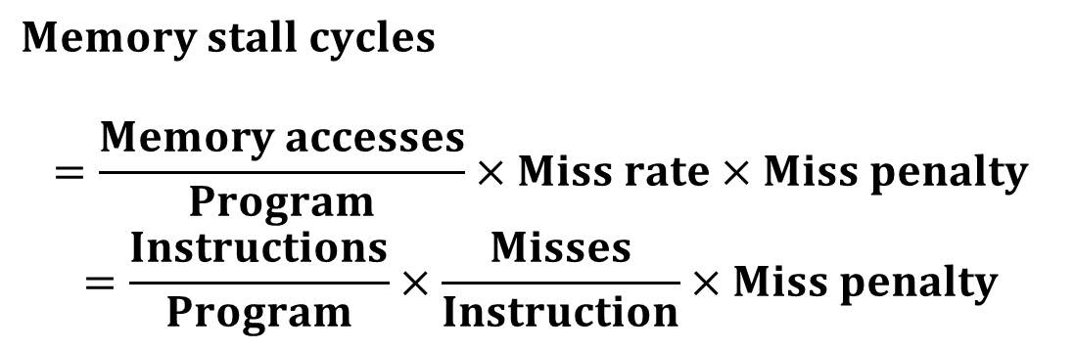
Measuring Cache Performance
Components of CPU time
Program execution cycles
Includes cache hit time
Memory stall cycles
Mainly from cache misses
With simplifying assumptions:
$$Memory stall cycles$$
$$=\frac{Memory accesses}{Program}×Miss rate×Miss penalty$$
$$=\frac{Instructions}{Program}×\frac{Misses}{Instruction}×Miss penalty$$

Slide 50
Cache Performance Example
Given
I-cache miss rate = 2%
D-cache miss rate = 4%
Miss penalty = 100 cycles
Base CPI (ideal cache) = 2
Load & stores are 36% of instructions
Compute the actual CPI?
Miss cycles per instruction
I-cache: 0.02 × 100 = 2
D-cache: 0.36 × 0.04 × 100 = 1.44
Actual CPI = 2 + 2 + 1.44 = 5.44
Ideal CPU is 5.44/2 =2.72 times faster

Slide 51
Average Access Time
Hit time is also important for performance
Average memory access time (AMAT)
AMAT = Hit time + Miss rate × Miss penalty
Example
CPU with 1ns clock, hit time = 1 cycle, miss penalty = 20 cycles, I-cache miss rate = 5%
AMAT = 1 + 0.05 × 20 = 2ns
2 cycles per instruction

Slide 52
Performance Summary
When CPU performance increased
Miss penalty becomes more significant
Decreasing base CPI
Greater proportion of time spent on memory stalls
Increasing clock rate
Memory stalls account for more CPU cycles
Can’t neglect cache behavior when evaluating system performance

Slide 53
Improving Cache Performance
Reduce the time to hit in the cache
Decreasing the miss ratio
Decreasing the miss penalty

Slide 54
Outline
Memory hierarchy
The basics of caches
Direct-mapped cache
Address sub-division
Cache hit and miss
Memory support
Measuring cache performance
Improving cache performance
Set associative cache
Multiple level cache
Virtual memory
Basics
Handling huge page table
TLB (Translation Lookaside Buffer)
TLB and cache
A common framework for memory hierarchy

Slide 55
Direct Mapped
Block Placement :
For each item of data at the lower level, there is exactly one location in cache where it might be
Address mapping: modulo number of blocks
0
1
0
1
0
1
0
1
0
0
1
1
0
0
1
1
0
0
0
0
1
1
1
1
0
0
0
0
1
0
0
1
0
1
0
1
0
0
1
0
1
1
0
1
1
0
0
0
1
1
0
1
0
1
1
1
0
0
1
1
1
1
0
1
M
e
m
o
r
y

Slide 56
Associative Caches
Fully associative
Allow a given block to go in any cache entry
Requires all entries to be searched at once
Comparator per entry (expensive)
n-way set associative
Each set contains n entries
Block number determines which set
(Block number) modulo (#Sets in cache)
Search all entries in a given set at once
n comparators (less expensive)

Slide 57
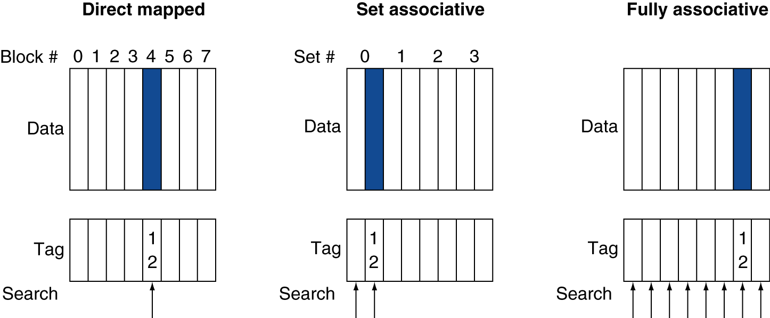
Associative Cache Example
Placement of a block whose address is 12:

Slide 58
Possible Associativity Structures
An 8-block cache

Slide 59
Associativity Example
Compare 4-block caches
Direct mapped, 2-way set associative, fully associative
Block access sequence: 0, 8, 0, 6, 8
Direct mapped
Block address | Cache index | Hit/miss | Cache content after access
 |  |  | 0 | 1 | 2 | 3
0 | 0 | miss | Mem[0]
8 | 0 | miss | Mem[8]
0 | 0 | miss | Mem[0]
6 | 2 | miss | Mem[0] |  | Mem[6]
8 | 0 | miss | Mem[8] |  | Mem[6]
time

Slide 60
Associativity Example
2-way set associative
Block address | Cache index | Hit/miss | Cache content after access
 |  |  | Set 0 |  | Set 1
0 | 0 | miss | Mem[0]
8 | 0 | miss | Mem[0] | Mem[8]
0 | 0 | hit | Mem[0] | Mem[8]
6 | 0 | miss | Mem[0] | Mem[6]
8 | 0 | miss | Mem[8] | Mem[6]
time
Fully associative
Block address |  | Hit/miss | Cache content after access
0 |  | miss | Mem[0]
8 |  | miss | Mem[0] | Mem[8]
0 |  | hit | Mem[0] | Mem[8]
6 |  | miss | Mem[0] | Mem[8] | Mem[6]
8 |  | hit | Mem[0] | Mem[8] | Mem[6]
time

Slide 61
How Much Associativity
Increased associativity decreases miss rate
But with diminishing returns
Simulation of a system with 64KB D-cache, 16-word blocks, SPEC2000
1-way: 10.3%
2-way: 8.6%
4-way: 8.3%
8-way: 8.1%

Slide 62
A 4-Way Set-Associative Cache
Increasing associativity shrinks index, expands tag

Slide 63
Comparing Data Available Time
62
Direct mapped cache
Cache block is available BEFORE Hit/Miss:
Possible to assume a hit and continue, recover later if miss
N-way set-associative cache
Data comes AFTER Hit/Miss decision
Extra MUX delay for the data

Slide 64
Data Placement Policy
Direct mapped cache:
Each memory block mapped to one location
No need to make any decision
Current item replaces previous one in location
N-way set associative cache:
Each memory block has choice of N locations
Fully associative cache:
Each memory block can be placed in ANY cache location
Misses in N-way set-associative or fully associative cache:
Bring in new block from memory
Throw out a block to make room for new block
Need to decide on which block to throw out

Slide 65
Cache Block Replacement
Direct mapped: no choice
Set associative or fully associative:
Random
LRU (Least Recently Used):
Hardware keeps track of the access history and replace the block that has not been used for the longest time
An example of a pseudo LRU (for a two-way set associative) :
use a pointer pointing at each block in turn
whenever an access to the block the pointer is pointing at, move the pointer to the next block
when need to replace, replace the block currently pointed at

Slide 66
Comparing the Structures
N-way set-associative cache
N comparators vs. 1
Extra MUX delay for the data
Data comes AFTER Hit/Miss decision and set selection
Direct mapped cache
Cache block is available BEFORE Hit/Miss:
Possible to assume a hit and continue, recover later if miss

Slide 67
Outline
Memory hierarchy
The basics of caches
Direct-mapped cache
Address sub-division
Cache hit and miss
Memory support
Measuring cache performance
Improving cache performance
Set associative cache
Multiple level cache
Virtual memory
Basics
Handling huge page table
TLB (Translation Lookaside Buffer)
TLB and cache
A common framework for memory hierarchy

Slide 68
Multilevel Caches
Primary cache attached to CPU
Small, but fast
Level-2 cache services misses from primary cache
Larger, slower, but still faster than main memory
Main memory services L-2 cache misses
Some high-end systems include L-3 cache

Slide 69
Multilevel Cache Example
Given
CPU base CPI = 1, clock rate = 4GHz
Miss rate/instruction = 2%
Main memory access time = 100ns
With just primary cache
Miss penalty = 100ns/0.25ns = 400 cycles
Effective CPI = 1 + 0.02 × 400 = 9

Slide 70
Example (cont.)
Now add L-2 cache
L-1 miss rate to L-2 = 2% (with one cache: to M)
L-2 access time = 5ns (to M: 100ns)
L-2 miss rate to main memory = 0.5%
Primary miss with L-2 hit (2%)
Penalty to access L-2 = 5ns/0.25ns = 20 cycles
Primary miss with L-2 miss (0.5%)
Penalty to access memory = 400 cycles
CPI = 1 + 0.02 × 20 + 0.005 × 400 = 3.4
Performance ratio = 9/3.4 = 2.6

Slide 71
Multilevel Cache Considerations
Primary cache
Focus on minimal hit time
L-2 cache
Focus on low miss rate to avoid main memory access
Hit time has less overall impact
Results
L-1 cache usually smaller than a single-level cache
L-1 block size smaller than L-2 block size

Slide 72
Interactions with Advanced CPUs
Out-of-order CPUs can execute instructions during cache miss
Pending store stays in load/store unit
Dependent instructions wait in reservation stations
Independent instructions continue
Effect of miss depends on program data flow
Much harder to analyze
Use system simulation

Slide 73
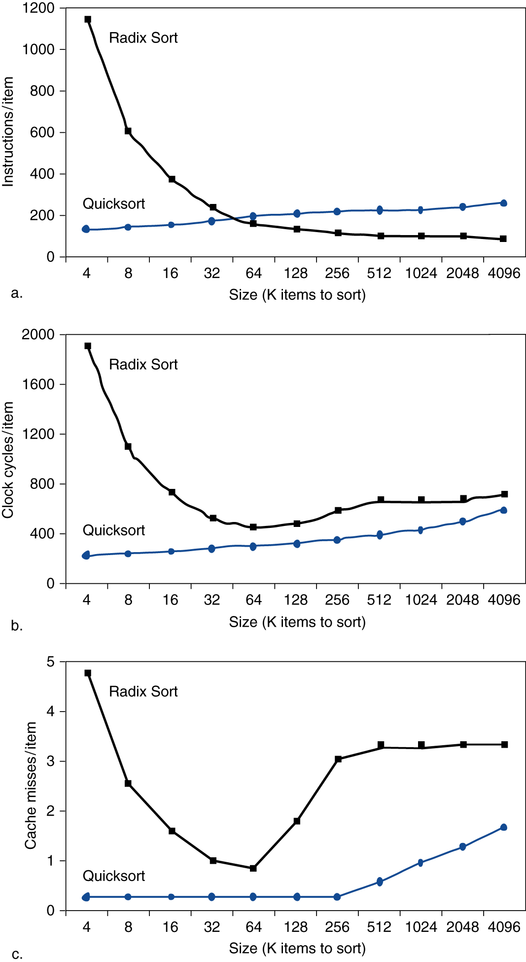
Interactions with Software
Misses depend on memory access patterns
Algorithm behavior
Compiler optimization for memory access

Slide 74
Outline
Memory hierarchy
The basics of caches
Direct-mapped cache
Address sub-division
Cache hit and miss
Memory support
Measuring cache performance
Improving cache performance
Set associative cache
Multiple level cache
Virtual memory
Basics
Issues in virtual memory
Handling huge page table
TLB (Translation Lookaside Buffer)
TLB and cache
A common framework for memory hierarchy

Slide 75
Levels of Memory Hierarchy
Upper Level
Staging
Transfer Unit
faster
Registers
Instr. Operands
prog./compiler
Cache
Blocks
cache controller
Memory
Pages
OS
Disk
Files
user/operator
Larger
Tape
Lower Level

Slide 76
Virtual Memory
cache
register
memory
disk
pages
frame
75

Slide 77
Diagram of Process State
admitted
interrupt
terminated
new
exit
ready
running
I/O or
event completion
scheduler dispatch
I/O or event wait
waiting

Slide 78
CPU Scheduler
selecting one of the ready processes, and allocates the CPU to it.
ready queue
CPU
I/O
I/O queue(s)

Slide 79
Virtual Memory
Programs share main memory (Multi-programming and I/O)
Program executed in a name space (virtual address space) different from memory space (physical address space)
Each gets a private virtual address space holding its frequently used code and data, starting at address 0, only accessible to itself
yet, any can run anywhere in physical memory
virtual memory implements the translation from virtual space to physical space
Every program has lots of memory (> physical memory)
Protected from other programs
Use main memory as a “cache” for secondary (disk) storage
Managed jointly by CPU hardware and the operating system (OS)

Slide 80
Virtual Memory - Continued
CPU and OS translate virtual addresses to physical addresses
VM “block” is called a page
VM translation “miss” is called a page fault

Slide 81
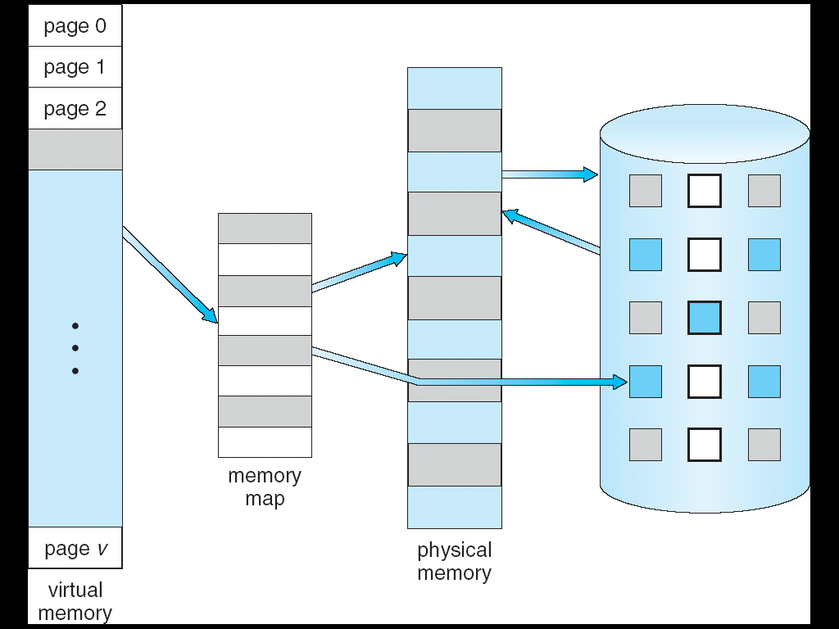
Virtual Memory
⇒
Notes:
80

Slide 82
Outline
Memory hierarchy
The basics of caches
Direct-mapped cache
Address sub-division
Cache hit and miss
Memory support
Measuring cache performance
Improving cache performance
Set associative cache
Multiple level cache
Virtual memory
Basics
Issues in virtual memory
Handling huge page table
TLB (Translation Lookaside Buffer)
TLB and cache
A common framework for memory hierarchy

Slide 83
Basic Issues in Virtual Memory
Size of data blocks that are transferred from disk to main memory
Which region of memory to hold new block => placement policy (how to the page?)
When memory is full, then some region of memory must be released to make room for the new block => replacement policy
When to fetch missing items from disk?
Fetch only on a fault => demand load policy
register
cache
disk
memory
pages
frame

Slide 84
Block Size and Placement Policy
Huge miss penalty: a page fault may take millions of cycles to process
Pages should be fairly large (e.g., 4KB) to amortize the high access time
Reducing page faults is important
fully associative placement => use page table (in memory) to locate pages

Slide 85
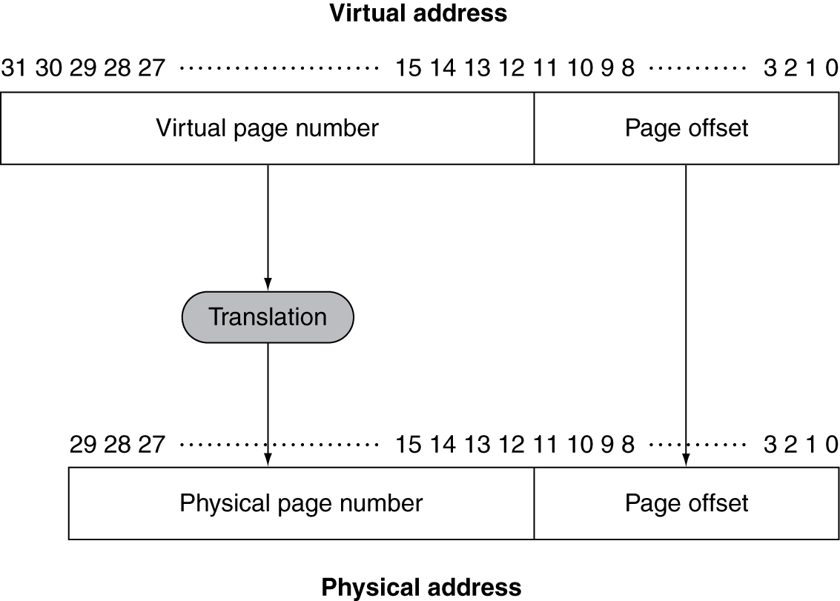
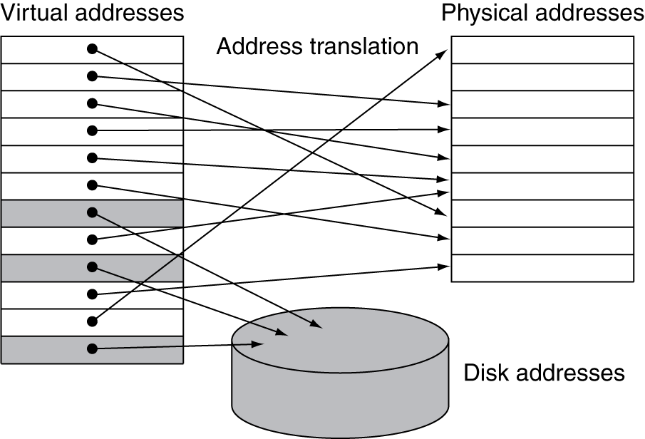
Address Translation
Fixed-size pages (e.g., 4K)

Slide 86
Paging
Virtual and physical address space partitioned into blocks of equal size
Key operation: address mapping
MAP: V → M ∪ {∅} address mapping function
MAP(a) = a' if data at virtual address a is present in physical address a' and a' in M
= ∅ if data at virtual address a is not present in M
pages
page frames
a
missing item fault
Name Space V
fault
handler
Processor
∅
Secondary
Memory
Addr Trans
Mechanism
Main
Memory
a
physical address
a'
OS does this transfer

Slide 87
Page Tables
Stores placement information
Page table stored in main memory
Array of page table entries, indexed by virtual page number
Page table register in CPU points to page table in physical memory
If page is present in memory
PTE stores the physical page number
Plus other status bits (referenced, dirty, …)
If page is not present
PTE can refer to location in swap space on disk

Slide 88
Page Tables
all addresses generated by the program are virtual addresses
How many memory references for each address translation?
Fig. 5.21
table located in physical memory

Slide 89
Page Fault: What Happens When You Miss?
Page hit, proceed normally
Page fault means that page is not resident in memory
Huge miss penalty: a page fault may take millions of cycles to process
Hardware must detect situation but it cannot remedy the situation
Can handle the faults in software instead of hardware, because handling time is small compared to disk access
the software can be very smart or complex
the faulting process can be context-switched

Slide 90
OS Handling Page Faults
Hardware must trap to the operating system so that it can remedy the situation
Pick a page to discard (may write it to disk)
Load the page in from disk
Update the page table
Resume to program so HW will retry and succeed!
In addition, OS must know where to find the page
Create space on disk for all pages of process (swap space)
Use a data structure to record where each valid page is on disk (may be part of page table)
Use another data structure to track which process and virtual addresses use each physical page => for replacement purpose

Slide 91
When to Fetch Missing Items From Disk
Fetch only on a fault
=> Demand load policy

Slide 92
Page Replacement and Writes
To reduce page fault rate, prefer least-recently used (LRU) replacement
Reference bit (aka use bit) in PTE set to 1 on access to page
Periodically cleared to 0 by OS
A page with reference bit = 0 has not been used recently
Disk writes take millions of cycles
Block at once, not individual locations
Write through is impractical
Use write-back
Dirty bit in PTE set when page is written

Slide 93
Problems of Page Table
Page table is too big
Access to page table is too slow (needs one memory read)

Slide 94
Problems of Page Table
Page table is too big
Access to page table is too slow (needs one memory read)

Slide 95
Outline
Memory hierarchy
The basics of caches
Direct-mapped cache
Address sub-division
Cache hit and miss
Memory support
Measuring cache performance
Improving cache performance
Set associative cache
Multiple level cache
Virtual memory
Basics
Issues in virtual memory
Handling huge page table
TLB (Translation Lookaside Buffer)
TLB and cache
A common framework for memory hierarchy

Slide 96
Impact of Paging: Huge Page Table
Page table occupies storage 32-bit VA, 4KB page, 4bytes/entry => 2²⁰ PTE, 4MB table
Possible solutions:
Use bounds register to limit table size; add more if exceed
Let pages to grow in both directions => 2 tables, 2 limit registers, one for hash, one for stack
Use hashing => page table same size as physical pages
Multiple levels of page tables
Paged page table (page table resides in virtual space)

Slide 97
Hashing: Inverted Page Tables
28-bit virtual address,4 KB per page, and 4 bytes per page-table entry
The number of pages: 64K
The number of physical frames: 16K
Page table size : 64 K (pages #) x 4 = 256 KB
Inverted page table : 16 K (frame #) x (4+?) = 64 KB
=> TLBs or virtually addressed caches are critical
Virtual
Page
Hash
V.Page P. Frame
=
Notes:
Page 520

Slide 98
Two-level Page Tables
32-bit address:
10
10
12
1K
PTEs
P1 index
P2 index
page offset
4KB
4 GB virtual address space
4 KB of PTE1
(Each entry indicate if any page in the segment is allocated)
4 MB of PTE2
paged, holes
4 bytes
What about a 48-64 bit address space?
4 bytes

Slide 99
Problems of Page Table
Page table is too big
Access to page table is too slow (needs one memory read)

Slide 100
Outline
Memory hierarchy
The basics of caches
Direct-mapped cache
Address sub-division
Cache hit and miss
Memory support
Measuring cache performance
Improving cache performance
Set associative cache
Multiple level cache
Virtual memory
Basics
Issues in virtual memory
Handling huge page table
TLB (Translation Lookaside Buffer)
TLB and cache
A common framework for memory hierarchy

Slide 101
Impact of Paging: More Memory Access !
Each memory operation (instruction fetch, load, store) requires a page-table access!
Basically double number of memory operations
One to access the PTE
Then the actual memory access
access to page tables has good locality

Slide 102
Fast Translation Using a TLB
Access to page tables has good locality
Fast cache of PTEs within the CPU
Called a Translation Look-aside Buffer (TLB)

Slide 103
Fast Translation Using TLB (Translation Lookaside Buffer)
TLB
Fig. 5.23

Slide 104
Translation Lookaside Buffer
Typical RISC processors have memory management unit (MMU) which includes TLB and does page table lookup
TLB can be organized as fully associative, set associative, or direct mapped
TLBs are small, typical: 16–512 PTEs, 0.5–1 cycle for hit, 10–100 cycles for miss, 0.01%–1% miss rate
Misses could be handled by hardware or software

Slide 105
TLB Hit
TLB hit on read
TLB hit on write:
Toggle dirty bit (write back to page table on replacement)

Slide 106
TLB Miss
If page is in memory
Load the PTE from memory and retry
Could be handled in hardware
Can get complex for more complicated page table structures
Or in software
Raise a special exception, with optimized handler
If page is not in memory (page fault)
OS handles fetching the page and updating the page table (software)
Then restart the faulting instruction

Slide 107
Outline
Memory hierarchy
The basics of caches
Direct-mapped cache
Address sub-division
Cache hit and miss
Memory support
Measuring cache performance
Improving cache performance
Set associative cache
Multiple level cache
Virtual memory
Basics
Issues in virtual memory
Handling huge page table
TLB (Translation Lookaside Buffer)
TLB and cache
A common framework for memory hierarchy

Slide 108
Making Address Translation Practical
In VM, memory acts like a cache for disk
Page table maps virtual page numbers to physical frames
Use a page table cache for recent translation => Translation Lookaside Buffer (TLB)
hit
VA
PA
miss
TLB
Lookup
Cache
Main
Memory
CPU
Translation
with a TLB
miss
hit
Trans-
lation
data
1/2 t
t
20 t

Slide 109
Integrating TLB and Cache
V
i
r
t
u
a
l
a
d
d
r
e
s
s
3
1
3
0
2
9
1
5
1
4
1
3
1
2
1
1
1
0
9
8
3
2
1
0
V
i
r
t
u
a
l
p
a
g
e
n
u
m
b
e
r
P
a
g
e
o
f
f
s
e
t
2
0
1
2
V
a
(Data)
l
i
d
D
i
r
t
y
P
h
y
s
i
c
a
l
p
a
g
e
n
u
m
b
e
T
a
g
r
T
L
B
T
L
B
h
i
t
2
0
P
h
y
s
i
c
a
l
p
a
g
e
n
u
m
b
e
r
P
a
g
e
o
f
f
s
e
P
h
t
y
s
i
c
a
l
a
d
d
r
e
s
s
B
y
t
P
h
y
s
e
i
c
a
l
a
d
d
r
e
s
s
t
a
g
C
a
c
h
e
i
n
d
e
x
o
f
f
s
e
t
1
6
1
4
2
T
a
g
D
a
t
V
a
a
l
i
d
C
a
c
h
e
Fig. 5.24
3
2
D
a
t
C
a
c
h
e
h
a
i
t

Slide 110
TLBs and caches

Slide 111
Possible Combinations of Events
Cache
TLB
Page
table
Possible? Conditions?
Miss
Hit
Hit
Yes; but page table never checked if
TLB hits
Hit
Miss
Hit
TLB miss, but entry found in page
table;after retry, data in cache
Miss
Miss
Hit
TLB miss, but entry found in page
table; after retry, data miss in cache
Miss
Miss
Miss
TLB miss and is followed by a page
fault; after retry, data miss in cache
Miss
Hit
Miss
impossible;
not in TLB if page not in memory
Hit
Hit
Miss
impossible;
not in TLB if page not in memory
Hit
Miss
Miss
impossible;
not in cache if page not in memory

Slide 112
Virtual Address and Cache
TLB access is serial with cache access
Cache is physically indexed and tagged
Alternative: virtually addressed cache
Cache is virtually indexed and virtually tagged
VA
PA
miss
CPU
Trans-
lation
Cache
Main
Memory
hit
data
CPU
VA
Trans-
lation
PA
Main
Memory
Cache
hit
data

Slide 113
Virtually Addressed Cache
Require address translation only on miss!
Problem:
Same virtual addresses (different processes) map to different physical addresses:
Synonym/alias problem: two different virtual addresses map to same physical address
Two different cache entries holding data for the same physical address!
For update: must update all cache entries with same physical address or memory becomes inconsistent
Determining this requires significant hardware, essentially an associative lookup on the physical address tags to see if you have multiple hits;
Or software enforced alias boundary: same least-significant bits of VA &PA > cache size
tag + process id

Slide 114
Integrating TLB and Cache
Fig. 5.24

Slide 115
An Alternative:Virtually Indexed but Physically Tagged (Overlapped Access)
TLB
Cache
associative
lookup
index
1 K
32
4 bytes
10
2
00
PA
Hit/
Miss
PA
Data
Hit/
Miss
20
12
page #
displace
=
IF cache hit AND (cache tag = PA) then deliver data to CPU
ELSE IF [cache invalid OR (cache tag ! = PA)] and TLB hit THEN
access memory with the PA from the TLB
ELSE do standard VA translation

Slide 116
Problem with Overlapped Access
Address bits to index into cache must not change as a result of VA translation
Limits to small caches, large page sizes, or high n-way set associativity if want a large cache
Ex.: cache is 8K bytes instead of 4K:
11
2
cache
index
00
This bit is changed by VA translation, but is needed for cache lookup
20
12
Solutions:
go to 8K byte page sizes;
go to 2 way set associative cache
SW guarantee VA[13]=PA[13]
virt page #
disp
1K
2-way set associative cache
10
4
4

Slide 117
Outline
Memory hierarchy
The basics of caches
Direct-mapped cache
Address sub-division
Cache hit and miss
Memory support
Measuring cache performance
Improving cache performance
Set associative cache
Multiple level cache
Virtual memory
Basics
Issues in virtual memory
Handling huge page table
TLB (Translation Lookaside Buffer)
TLB and cache
A common framework for memory hierarchy

Slide 118
The Memory Hierarchy
The BIG Picture
Common principles apply at all levels of the memory hierarchy
Based on notions of caching
At each level in the hierarchy
Block placement
Finding a block
Replacement on a miss
Write policy

Slide 119
Block Placement
Determined by associativity
Direct mapped (1-way associative)
One choice for placement
n-way set associative
n choices within a set
Fully associative
Any location
Higher associativity reduces miss rate
Increases complexity, cost, and access time

Slide 120
Finding a Block
Associativity | Location method | Tag comparisons
Direct mapped | Index | 1
n-way set associative | Set index, then search entries within the set | n
Fully associative | Search all entries | #entries
 | Full lookup table | 0
Hardware caches
Reduce comparisons to reduce cost
Virtual memory
Full table lookup makes full associativity feasible
Benefit in reduced miss rate

Slide 121
Replacement
Choice of entry to replace on a miss
Least recently used (LRU)
Complex and costly hardware for high associativity
Random
Close to LRU, easier to implement
Virtual memory
LRU approximation with hardware support

Slide 122
Write Policy
Write-through
Update both upper and lower levels
Simplifies replacement, but may require write buffer
Write-back
Update upper level only
Update lower level when block is replaced
Need to keep more state
Virtual memory
Only write-back is feasible, given disk write latency

Slide 123
Sources of Misses
Compulsory misses (aka cold start misses)
First access to a block
Capacity misses
Due to finite cache size
A replaced block is later accessed again
Conflict misses (aka collision misses)
In a non-fully associative cache
Due to competition for entries in a set
Would not occur in a fully associative cache of the same total size

Slide 124
Challenge in Memory Hierarchy
Every change that potentially improves miss rate can negatively affect overall performance
Design change Effects on miss rate Possible effects
size ↑ capacity miss ↓ access time ↑
associativity ↑ conflict miss ↓ access time ↑
block size ↑ spatial locality ↑ miss penalty ↑
Trends:
Synchronous SRAMs (provide a burst of data)
Redesign DRAM chips to provide higher bandwidth or processing
Restructure code to increase locality
Use prefetching (make cache visible to ISA)

Slide 125
Outline
Memory hierarchy
The basics of caches
Measuring and improving cache performance
Virtual memory
A common framework for memory hierarchy
Using a Finite State Machine to Control a Simple Cache
Parallelism and Memory Hierarchies: Cache Coherence

Slide 126
Cache Control
Example cache characteristics
Direct-mapped, write-back, write allocate
Block size: 4 words (16 bytes)
Cache size: 16 KB (1024 blocks)
32-bit byte addresses
Valid bit and dirty bit per block
Blocking cache
CPU waits until access is complete
31
14
13
4
3
0
Tag
Index
Offset
18 bits
10 bits
4 bits

Slide 127
Interface Signals
CPU
Cache
Memory
Read/Write
Read/Write
Valid
Valid
Address
32
Address
32
Write Data
32
Write Data
128
Read Data
32
Read Data
128
Ready
Ready
Multiple cycles per access

Slide 128
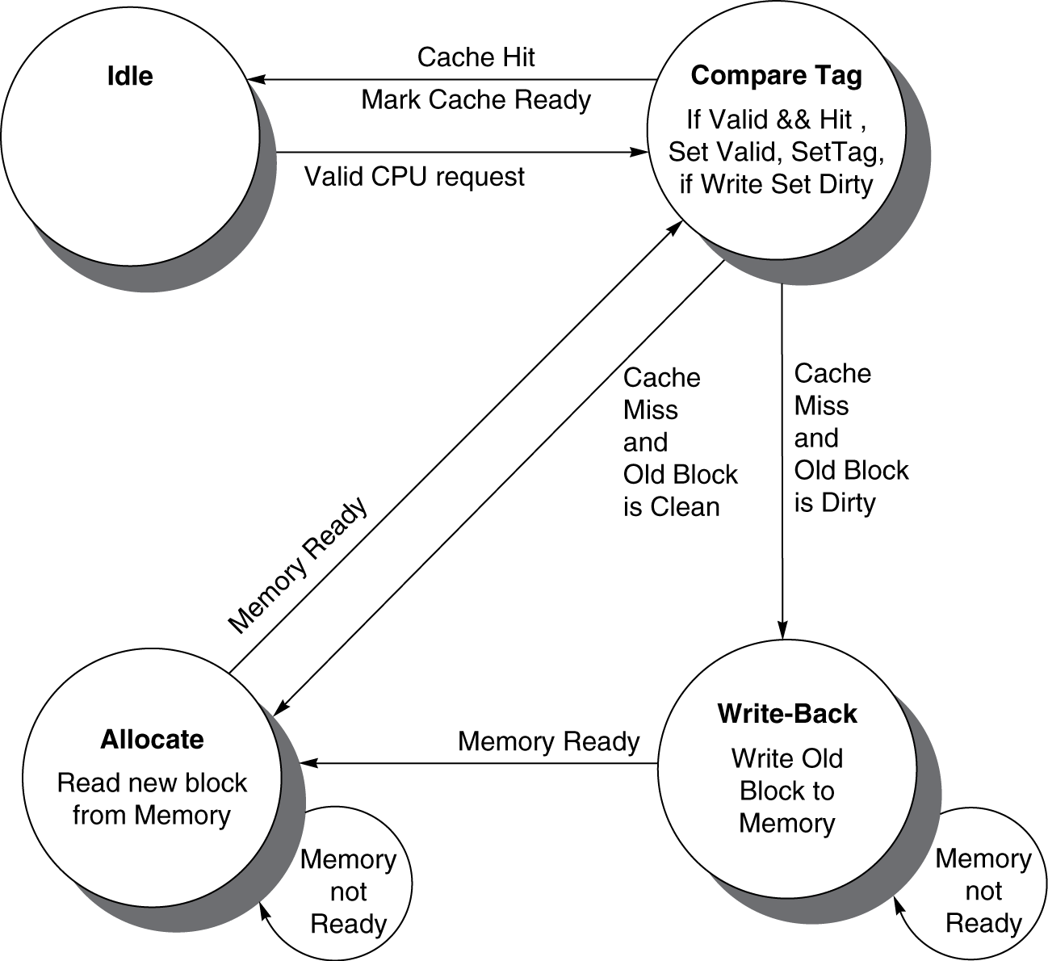
Cache Controller FSM
Could partition into separate states to reduce clock cycle time

Slide 129
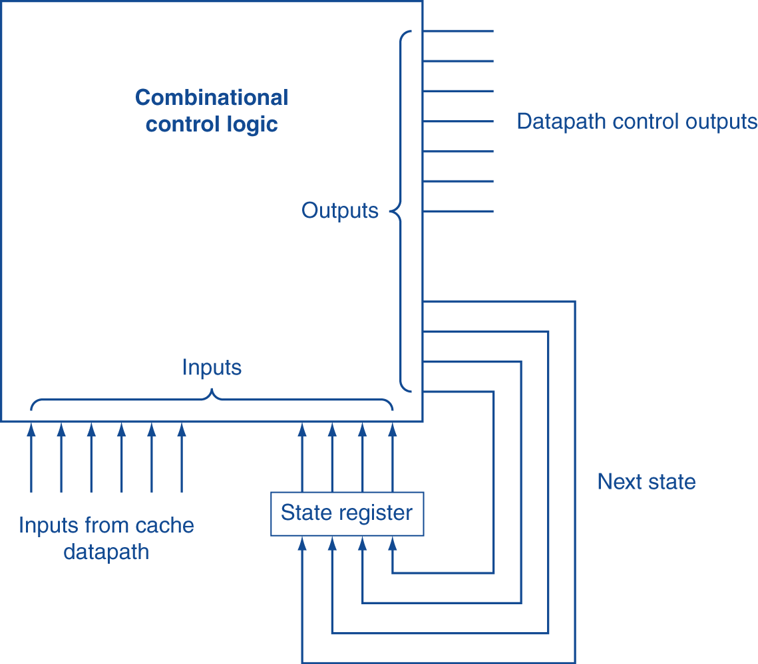
Finite State Machines
Use an FSM to sequence control steps
Set of states, transition on each clock edge
State values are binary encoded
Current state stored in a register
Next state = f_{n} (current state, current inputs)
Control output signals = f_{o} (current state)

Slide 130
Outline
Memory hierarchy
The basics of caches
Measuring and improving cache performance
Virtual memory
A common framework for memory hierarchy
Using a Finite State Machine to Control a Simple Cache
Parallelism and Memory Hierarchies: Cache Coherence

Slide 131
Cache Coherence Problem
Suppose two CPU cores share a physical address space
Write-through caches
Time step | Event | CPU A’s cache | CPU B’s cache | Memory
0 |  |  |  | 0
1 | CPU A reads X | 0 |  | 0
2 | CPU B reads X | 0 | 0 | 0
3 | CPU A writes 1 to X | 1 | 0 | 1
Two different processors have two different values for the same location

Slide 132
Coherence Defined
Informally: Reads return most recently written value
Formally:
P writes X; P reads X (no intervening writes) ⇒ read returns written value
P₁ writes X; P₂ reads X (sufficiently later) ⇒ read returns written value
c.f. CPU B reading X after step 3 in example
P₁ writes X, P₂ writes X ⇒ all processors see writes in the same order
End up with the same final value for X

Slide 133
Cache Coherence Protocols
Operations performed by caches in multiprocessors
Migration of data to local caches
Reduces bandwidth for shared memory
Replication of read-shared data
Reduces contention for access
Snooping protocols
Each cache monitors bus reads/writes
Directory-based protocols
Caches and memory record sharing status of blocks in a directory

Slide 134
Invalidating Snooping Protocols
Cache gets exclusive access to a block when it is to be written
Broadcasts an invalidate message on the bus
Subsequent read in another cache misses
Owning cache supplies updated value
CPU activity | Bus activity | CPU A’s cache | CPU B’s cache | Memory
 |  |  |  | 0
CPU A reads X | Cache miss for X | 0 |  | 0
CPU B reads X | Cache miss for X | 0 | 0 | 0
CPU A writes 1 to X | Invalidate for X | 1 |  | 0
CPU B read X | Cache miss for X | 1 | 1 | 1

Slide 135
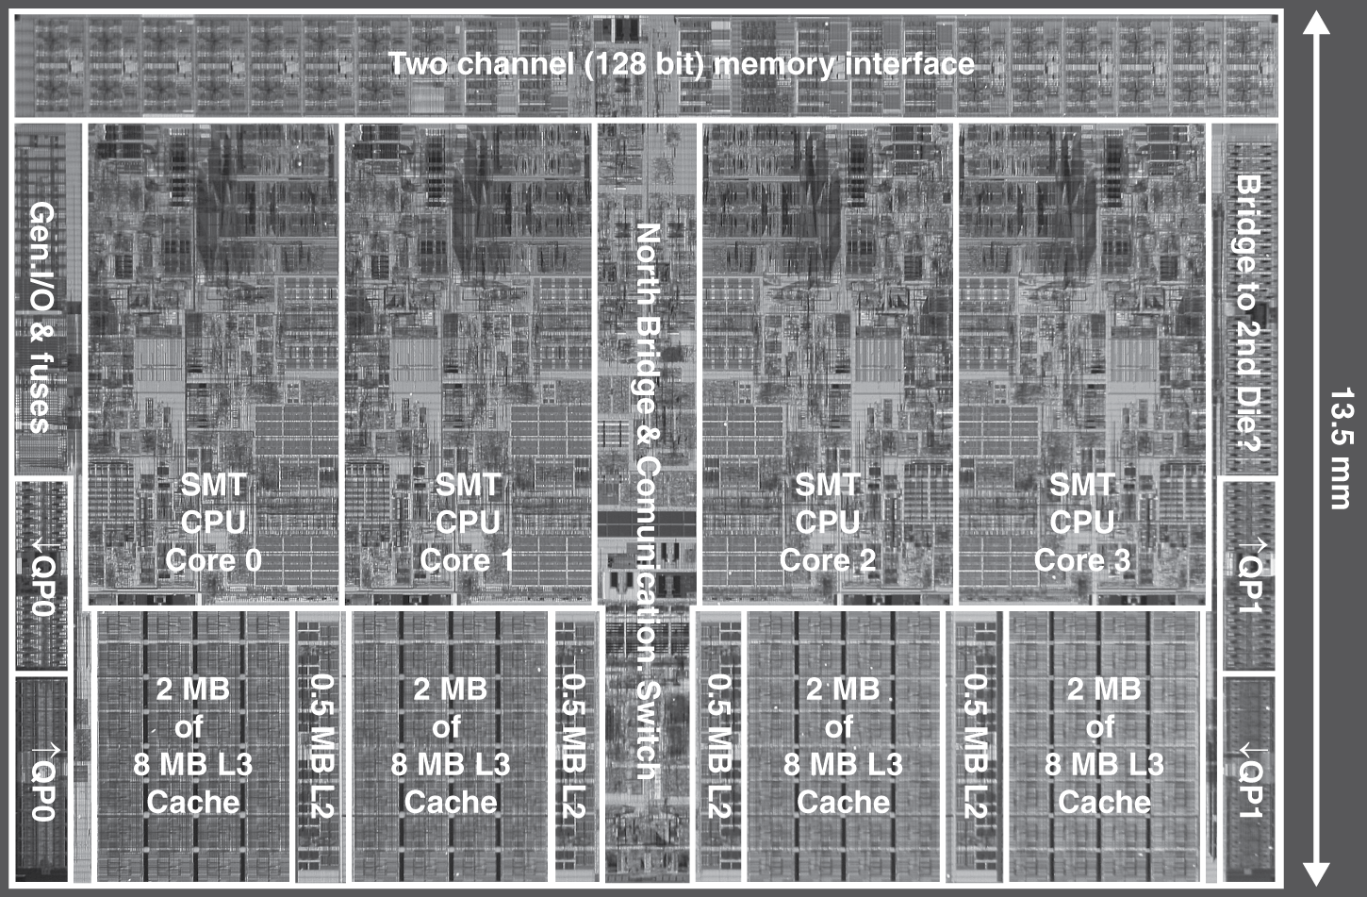
Multilevel On-Chip Caches
Intel Nehalem 4-core processor
§5.10 Real Stuff: The AMD Opteron X4 and Intel Nehalem
Per core: 32KB L1 I-cache, 32KB L1 D-cache, 512KB L2 cache

Slide 136
2-Level TLB Organization
 | Intel Nehalem | AMD Opteron X4
Virtual addr | 48 bits | 48 bits
Physical addr | 44 bits | 48 bits
Page size | 4KB, 2/4MB | 4KB, 2/4MB
L1 TLB (per core) | L1 I-TLB: 128 entries for small pages, 7 per thread (2×) for large pages L1 D-TLB: 64 entries for small pages, 32 for large pages Both 4-way, LRU replacement | L1 I-TLB: 48 entries L1 D-TLB: 48 entries Both fully associative, LRU replacement
L2 TLB (per core) | Single L2 TLB: 512 entries 4-way, LRU replacement | L2 I-TLB: 512 entries L2 D-TLB: 512 entries Both 4-way, round-robin LRU
TLB misses | Handled in hardware | Handled in hardware

Slide 137
3-Level Cache Organization
 | Intel Nehalem | AMD Opteron X4
L1 caches (per core) | L1 I-cache: 32KB, 64-byte blocks, 4-way, approx LRU replacement, hit time n/a L1 D-cache: 32KB, 64-byte blocks, 8-way, approx LRU replacement, write-back/allocate, hit time n/a | L1 I-cache: 32KB, 64-byte blocks, 2-way, LRU replacement, hit time 3 cycles L1 D-cache: 32KB, 64-byte blocks, 2-way, LRU replacement, write-back/allocate, hit time 9 cycles
L2 unified cache (per core) | 256KB, 64-byte blocks, 8-way, approx LRU replacement, write-back/allocate, hit time n/a | 512KB, 64-byte blocks, 16-way, approx LRU replacement, write-back/allocate, hit time n/a
L3 unified cache (shared) | 8MB, 64-byte blocks, 16-way, replacement n/a, write-back/allocate, hit time n/a | 2MB, 64-byte blocks, 32-way, replace block shared by fewest cores, write-back/allocate, hit time 32 cycles
n/a: data not available

Slide 138
Pitfalls
Byte vs. word addressing
Example: 32-byte direct-mapped cache, 4-byte blocks
Byte 36 maps to block 1
Word 36 maps to block 4
Ignoring memory system effects when writing or generating code
Example: iterating over rows vs. columns of arrays
Large strides result in poor locality

Slide 139
Pitfalls
In multiprocessor with shared L2 or L3 cache
Less associativity than cores results in conflict misses
More cores ⇒ need to increase associativity
Using AMAT (Average Memory Access Time) to evaluate performance of out-of-order processors
Ignores effect of non-blocked accesses
Instead, evaluate performance by simulation

Slide 140
Concluding Remarks
Fast memories are small, large memories are slow
We really want fast, large memories ☹
Caching gives this illusion ☺
Principle of locality
Programs use a small part of their memory space frequently
Memory hierarchy
L1 cache ↔ L2 cache ↔ … ↔ DRAM memory ↔ disk
Memory system design is critical for multiprocessors

